Slide 1
Measuring Primary Care Spending in Maine
January 20, 2015
Lacey Hartman
Sr. Research Fellow

Slide 2
Overview
Goal: build consensus on method for measuring primary care $ in Maine
  Conceptual differences across methods
  Examples: OR, VT, Primary Care Incentive Program (PCIP)
  Discussion

Slide 3
Key Inputs and Decisions to Define Primary Care Spending
What “counts” as primary care, based on
  Defined list of physician specialty, and/or CPT codes
  “Grouper” to define primary care (e.g., Milliman HCG)
Data Sources
  Claims (APCD)
  Data from insurers

Slide 4
Example: Oregon
Tracks PMPM primary care spending as part of quarterly health policy dashboard
  Report separately for commercial, Medicaid MC, and Medicare Advantage
Data source: APCD
  “allowed” amounts
Analytic approach
    Milliman’s Health Cost Guidelines (grouper)

Slide 5
Oregon definition of primary care
Included all “preventive” codes from the Milliman HCG
HCG GRP | Description
O51a | FOP Preventive - General
O51b | FOP Preventive - Colonoscopy
O51c | FOP Preventive - Mammography
O51d | FOP Preventive - Lipid Panel
P32c | PROF Office/Home Visits - PCP
P40a | PROF Preventive Other - General
P40b | PROF Preventive Other - Colonoscopy
P40c | PROF Preventive Other - Mammography
P40d | PROF Preventive Other - Lab
P41 | PROF Preventive Immunizations
P42 | PROF Preventive Well Baby Exams
P43 | PROF Preventive Physical Exams

Slide 6
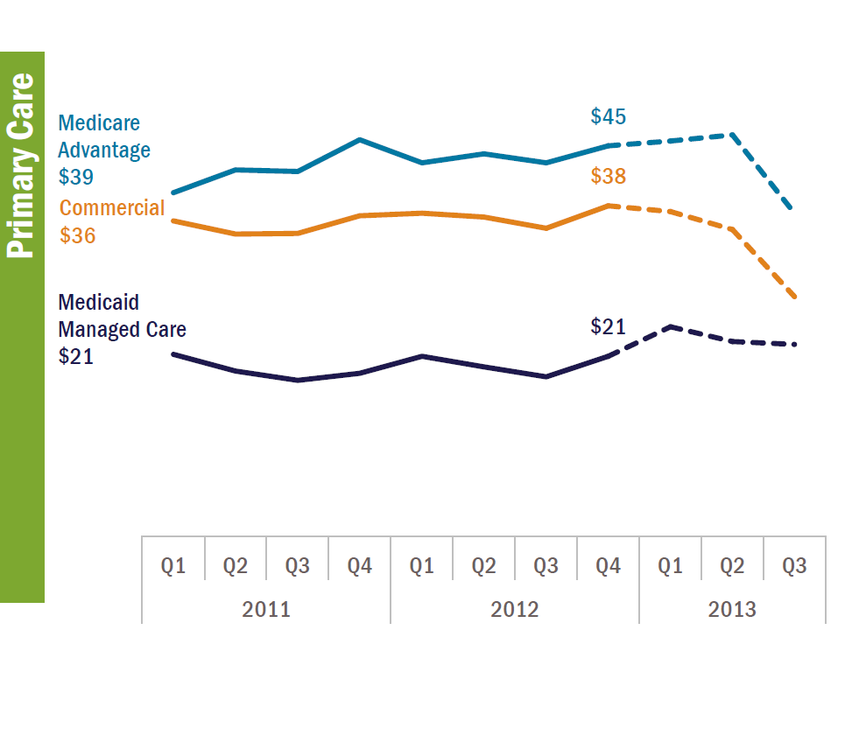
Oregon: PMPM on Primary Care
Source: Oregon Health Policy Dashboard, June 2014. Analysis of APAC.
Note: First 3 quarters of 2013 incomplete data due to claims lag.

Slide 7
DRAFT: Preliminary Results
Primary care spending as % of total
Source: Oregon Health Authority

Slide 8
Vermont: Primary Care Service Areas (PCSAs)
2010 study to track utilization and expenditure flows for primary care
Provider types: family medicine, internal medicine, pediatrics, registered nurses, and physician assistants
Evaluation and management codes for office visits, consultations, nursing care, home services, preventive medical visits, counseling, and newborn care

Slide 9
CMS Primary Care Incentive Program (PCIP)
Definition to determine eligibility for PC payment “bump”
Provider types: Family practice, internal medicine, pediatrics, geriatrics, NPs, certified clinical nurse specialist, physician assistant
Evaluation and management codes for:
  Office/outpatient visits
  Domiciliary, rest home, home care plan services
  Home visits

Slide 10
Comparison: Provider Types
Provider Types | PCIP | VT | RI
Nurse practitioners | ✓ |  | ✓
Physician Assistants | ✓ | ✓ | ✓
Clinical nurse specialist | ✓
RNs |  | ✓
Family Practice | ✓ | ✓ | ✓
Internal Medicine | ✓ | ✓ | ✓
Pediatrics |  | ✓ | ✓
Geriatrics | ✓

Slide 11
Comparison: Service Codes
 | VT | PCIP
Office and outpatient visits, new and established | ✓ | ✓
Nursing facility services | ✓ | ✓
Domicilliary, rest home, custodial care | ✓ | ✓
Home services | ✓ | ✓
Consultations | ✓
Preventive medicine services (physicals) | ✓
Counseling : risk factor reduction and behavior change intervention (separate visits) | ✓
Newborn care services | ✓
FQHC - global visit | ✓

Slide 12
Discussion
Which approaches resonate most with the group’s goals around increasing primary care investment? Are there services/elements of certain definitions that don’t make sense for Maine? Is anything missing?

Slide 13
Types of Services Provider Types
Evaluation and management
Preventive visits/physicals
Risk factor counseling
Nursing home/rest home/domicilliary
Home services
Newborn services
Consultations
Cancer screenings
Others?
Internal Medicine
Family Practice
Pediatrics
Geriatrics
NPs
PAs
Others?

Slide 14
Discussion, continued
What are the relevant data limitations/gaps (e.g., incentive payments)? What are potential strategies for filling those gaps?
Would a phased approach to defining and measuring primary care investment make sense (e.g., beginning with a more basic approach given available data and resources, and honing the approach over time). How would that look/be operationalized?
Are there key stakeholders outside of this group that are needed to move forward on finalizing a definition and measurement approach for primary care investment, both from a policy (e.g., clinicians and payers) and technical (e.g. accessing necessary data) perspective?

Slide 15
Potential Next Steps
“Further” modified RI approach—condition on some subset of services delivered by NPI defined “primary care” providers
Explore the use of a grouper
Sensitivity analyses

